Slide 1
DATA IS NOT A BUSINESS MODEL: MOVING KNOWLEDGE TO ACTION
Jen van der meer
STRATA 2013 FEBRUARY 26, 2013
Luminary labs | NYU ITP | SVA POD
Jen van der Meer @jenvandermeer
www.jenvandermeer.com

Slide 2
3 QUICK STORIES

Slide 3
1: LESSONS FROM A TRADING ROOM FLOOR
Circa 1993

Slide 4


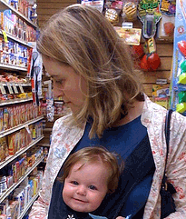




ABOUT ME

Slide 5

BUT I WAS BORN HERE
Results from a recent customer discovery exercise from a big data software company in the health care space.
N = 24. *Over cocktails.

Slide 6
“REVENUE UP. 30%.
EPS FLAT AT 1% ....”
February 26, 2013

Slide 7
“WHAT THE &*%# YOU @#%$ HOW CAN $!#* BE MOVING LIKE A #$%& ON A*&#% BUT EPS IN THE #$%* GO #%$@ YOU $*#”
February 26, 2013

Slide 8

LESSON 1: INSIGHT TRUMPS DATA
February 26, 2013

Slide 9
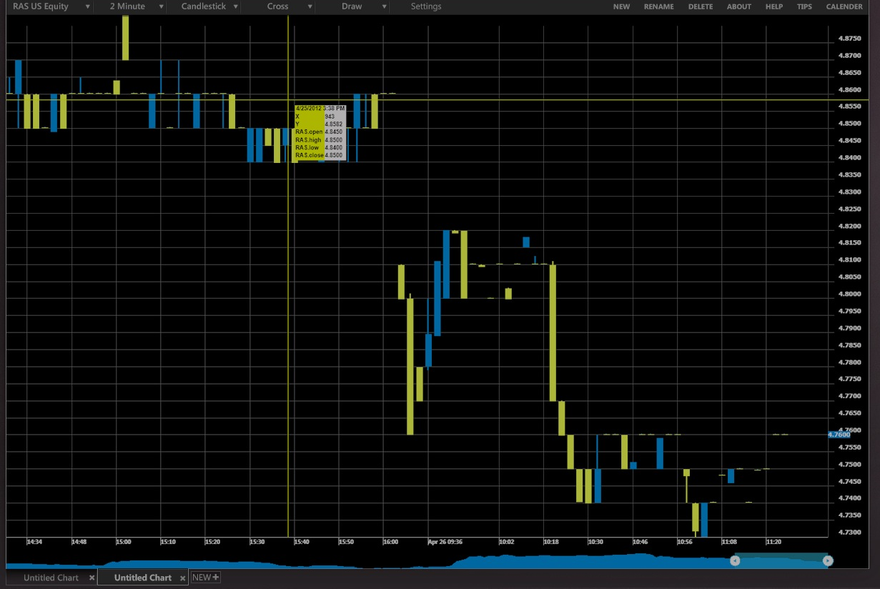
LESSON 2: ACTION TRUMPS WISDOM
February 26, 2013

Slide 10

LESSON 3: ALL BUSINESS MODELS LADDER UP TO REVS COST
February 26, 2013

Slide 11

February 26, 2013

Slide 12
2: ACTION IS THE SCARCEST RESOURCE

Slide 13

@gothamgal

Slide 14
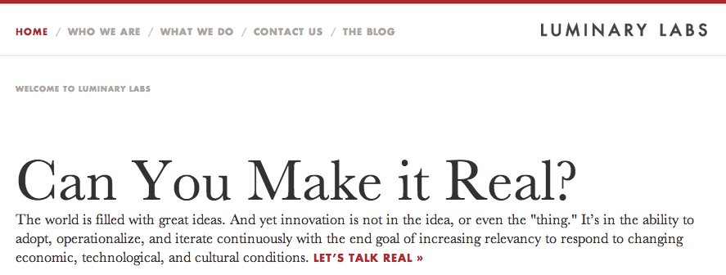

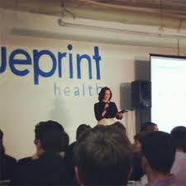

Get luminary website here….

Slide 15
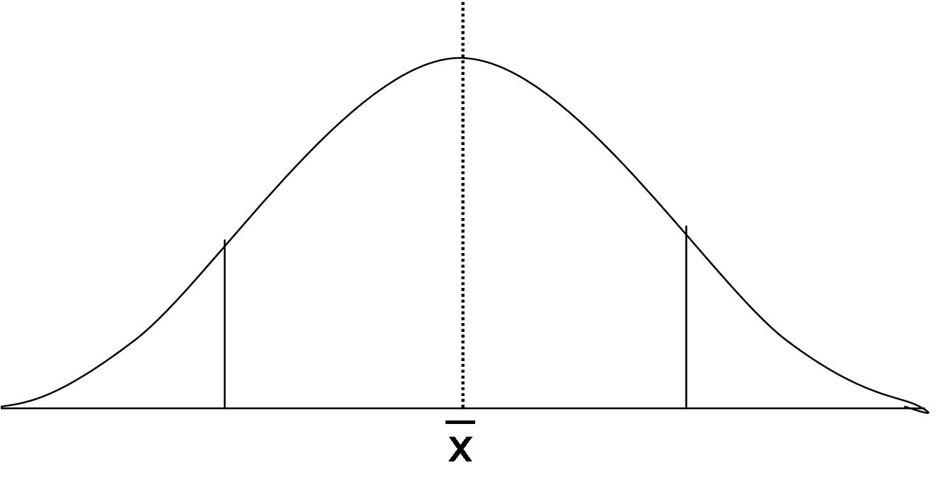
THE SPREAD OF NEW IDEAS
Whoops
Idea not breakthrough, addressable market too small
Great potential idea, uncertain or unlikely business models
Great idea, identified business model potential

Slide 16
HOW MUCH IS YOUR DATA WORTH?
The single biggest error new companies make in estimating their potential growth: overvaluing the value of the data itself.
“We have a consumer based model and we’ll sell data to small businesses to tell them how we’re doing.”
“We know how to find patterns in unstructured data and we can sell this to data brokers and to developer APIs.”
“We collect lots of interesting social data about how people interact with brands at the store level and we’ll sell that data back to CPG brands that have no direct touchpoint.”
“We have a novel data source triangulating accelerometer data with GPS and loyalty points, which is a unique and proprietary algorithm that will measure behavior change…”

Slide 17
ACTION SITS ON TOP OF THE WISDOM PYRAMID
Wisdom
Knowledge
Information
Data
Action
Value to drive Revs up,
Cost down
“Alas, how terrible is wisdom
when it brings no profit to the man that's wise!”
– Sophocles

Slide 18
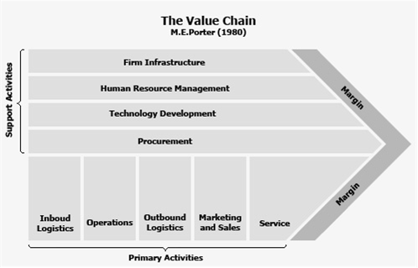
ACTION TO INCREASE REVS, DECREASE COST

Slide 19
WHAT ACTION ARE YOU INFORMING, BIG DATA?
Score
Company descriptions for innovative big data companies:
_____ indexes and makes searchable data from any app, server or network device in real time including logs, config files, messages, alerts, scripts and metrics.
______ makes sense of the world's public data to help your company answer billion dollar questions. To solve technology challenges, identify target companies, and detect disruptive trends.
______ is an innovative solution for statistical/analytics outsourcing. We are the leading platform for predictive modeling competitions. Companies, governments and researchers present datasets and problems - the world's best data scientists then compete to produce the best solutions.
_______ is the single application for big data analytics. Data integration, data analytics and data visualization with the Business Infographic™ designer.
Notes:
Splunk. Quid. Kaggle. Datameer.

Slide 20
CUSTOMER DISCOVERY: HOW DO YOU USE BIG DATA INSIGHTS?

Slide 21

“I’m using insights from big data to see if I’m reaching my target segment, and then richly understanding these segments in new ways.”

Slide 22

“We need to get customer insight to the front lines to reduce customer churn, not just in some exec’s inbox in a PDF report, or worse on a never-seen real time dashboard.”

Slide 23

“We’re trying to get a moneyball way of looking at the business. But we’re facing fierce resistance from the marketing and front office teams. Big data hasn’t left IT.”

Slide 24
DATA IS THE COMMODITY, ACTION BASED ON WISDOM IS THE SCARCE RESOURCE

Slide 25

SO WHY DO WE FEEL WE STILL NEED TO LOCK UP OUR DATA SETS?

Slide 26
3:
LIBERATE THE DATA FOR FUN AND PROFIT

Slide 27
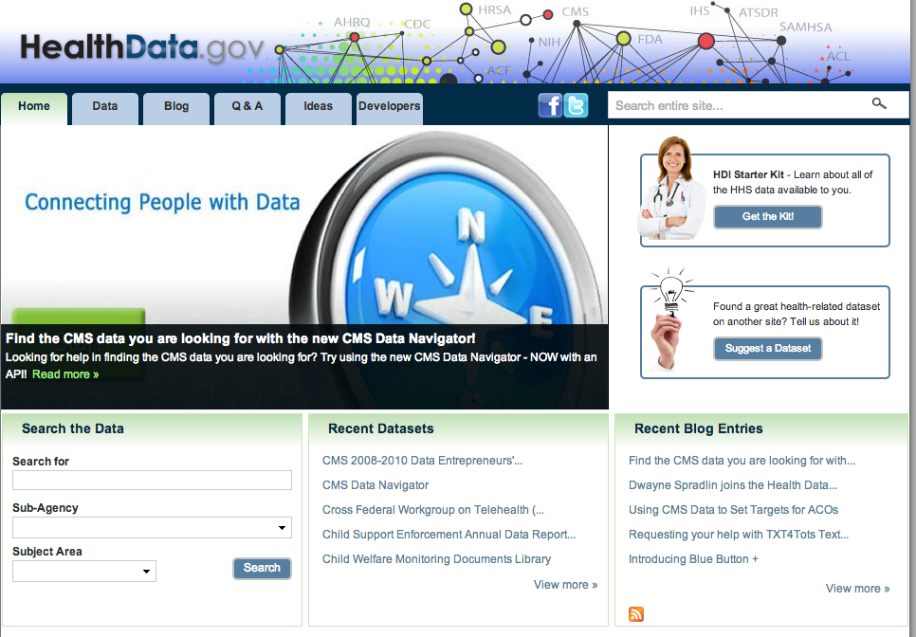
THE OPEN DATA MOVEMENT AND HEALTH CARE

Slide 28
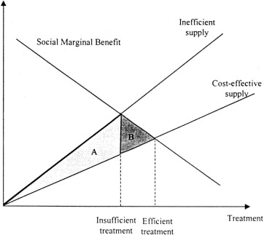
OPEN DATA IS A POSITIVE EXTERNALITY
CLOSED DATA IS A NEGATIVE EXTERNALITY
Notes:
A negative externality occurs when an individual or firm making a decision does not have to pay the full cost of the decision. If a good has a negative externality, then the cost to society is greater than the cost the customer is paying for it.
Since consumers make a decision based on where their marginal cost equals their marginal benefit, and since they don't take into account the cost of the negative externality, negative externalities result in market inefficiencies unless proper action is taken.
When a negative externality exists in an unregulated market, producers don't take responsibility for external costs that exist--these are passed on to society. Thus producers have lower marginal costs than they would otherwise have and the supply curve is effectively shifted down (to the right) of the supply curve that society faces. Because the supply curve is increased, more of the product is bought than the efficient amount--that is, too much of the product is produced and sold. Since marginal benefit is not equal to marginal cost, a deadweight welfare loss results.

Slide 29
WHAT IS THE THE VALUE OF UNDERLYING DATA IN A COMPLEX ADAPTIVE SYSTEM?
Notes:
Diversity of Interactions matter more than the size of the data.

Slide 30
CANCER CARE ONCE WE ACHIEVE DATA LIQUIDITY
All types of researchers in various disciplines—including basic science, drug discovery, clinical and translational, epidemiologic, and patient behavior—will have access to the requisite data to advance their research.
Clinicians will have immediate access to cross-sectional, trending, and performance data that may facilitate improved clinical decision making.
Patients will have real-time access to information for finding reliable sources pertinent to their particular condition and in finding expertise tailored to their individual needs.
Product innovators will have the ability to query large amounts of phenotypic and molecular data, and rapidly scan patient populations for recruitment into clinical trials.
DRAFT: Achieving Data Liquidity in the Cancer Community: Proposal for a Coalition of All Stakeholders. Members of the IOM National Cancer Policy Forum’s Workshop on Informatics Needs and Challenges in Cancer Research Planning Committee. Author’s views, not nec. IOM views.

Slide 31

DATA AS PUBLIC COMMONS

Slide 32
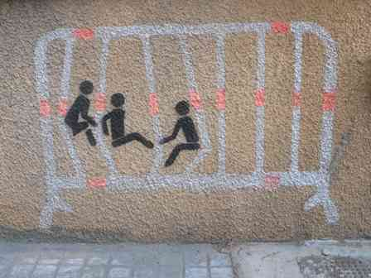
SO HERE’S AN IDEA…

Slide 33
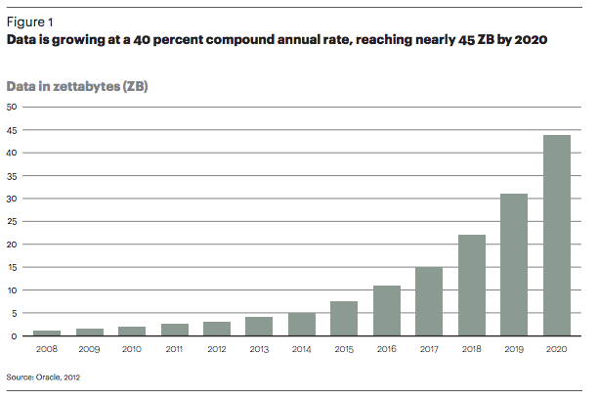
THE OBLIGATORY CAGR OF BIG DATA CHART

Slide 34
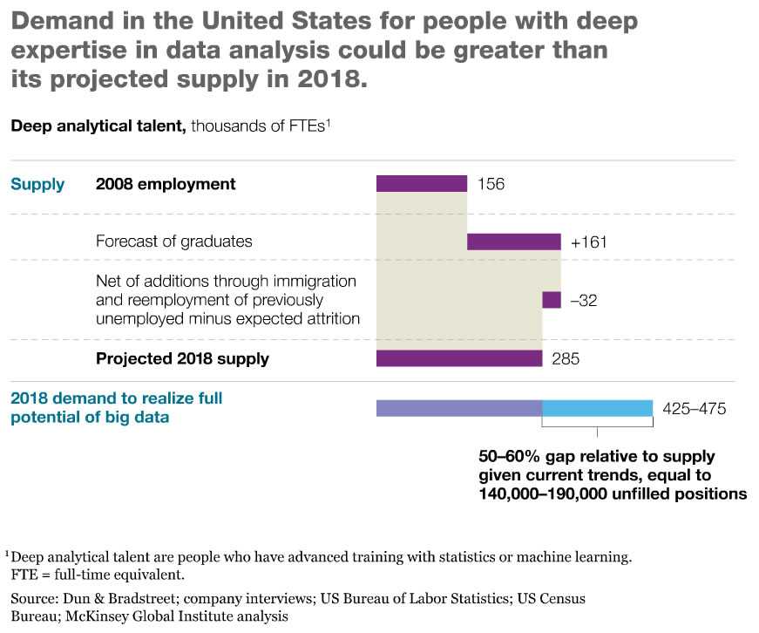
THE OBLIGATORY SHORTAGE OF DATA SCIENTISTS WARNING

Slide 35
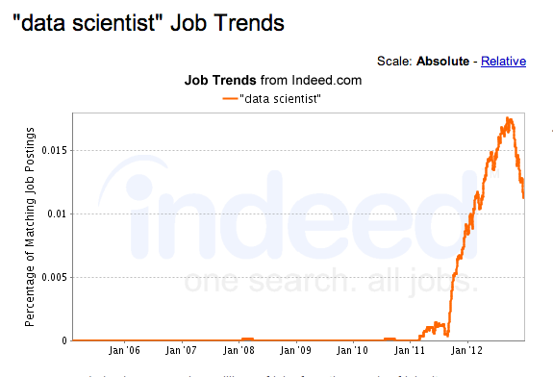
AND THE OBLIGATORY HYPE CYCLE INDICATOR CHART

Slide 36

WHAT IF

Slide 37

ALL OF THE NEWLY MINTED DATA SCIENTISTS, ON THEIR WAY DOWN TO THE BIG DATA TROUGH OF DISILLUSIONMENT,
BANDED TOGETHER

Slide 38

AND ONLY WORKED ON THE MOST INTERESTING INSIGHTS, TO GENERATE THE MOST PRODUCTIVE ACTIONS?

Slide 39
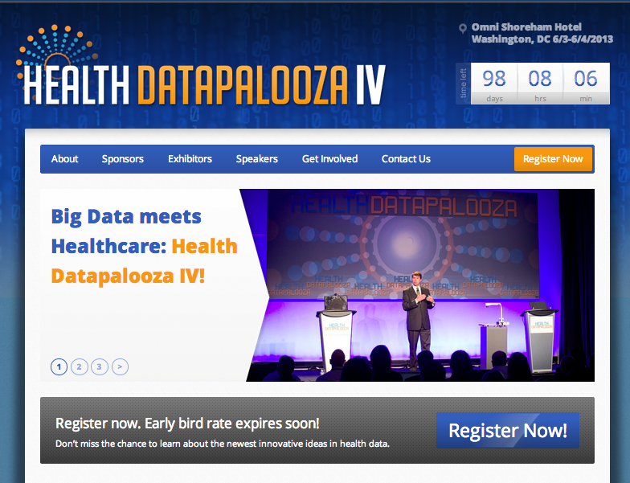

Slide 40
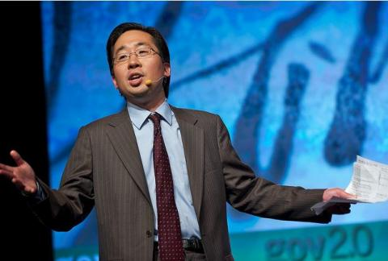
The goal is really to spur the emergence of an ecosystem of innovators that leverage this open data in magical ways to improve health and healthcare in ways that no one organization, no ten organizations, could even think up let alone execute.
.- Todd Park,

Slide 41
HEALTH CARE + OPEN DATA.
PATIENTS, PHYSICIANS, AND PAYERS INCENTIVIZED TO DELIVER THE WISEST ACTION.

Slide 42
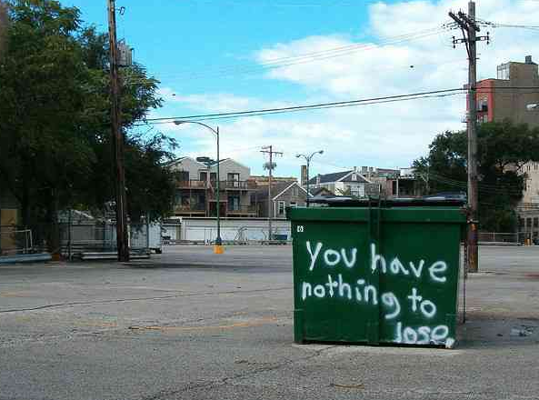
Thank you. @jenvandermeer

